Slide 1

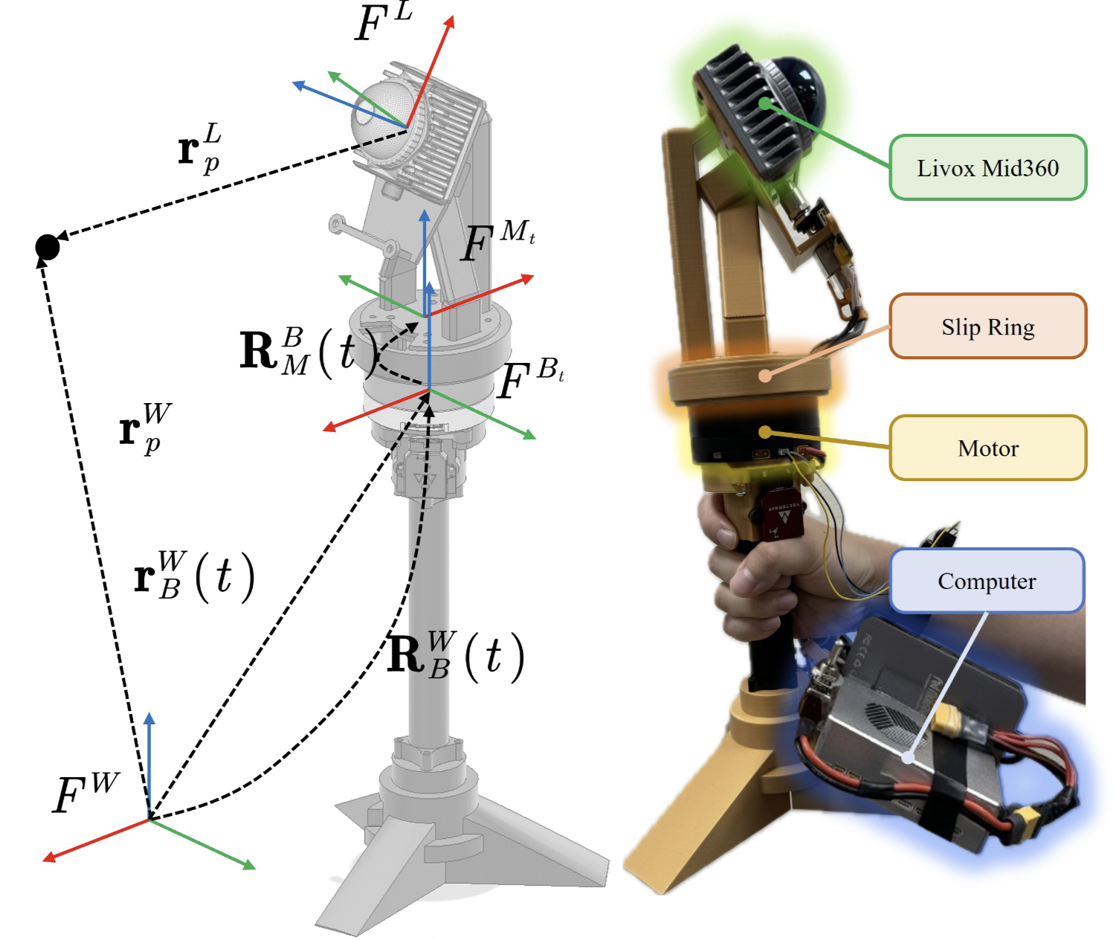
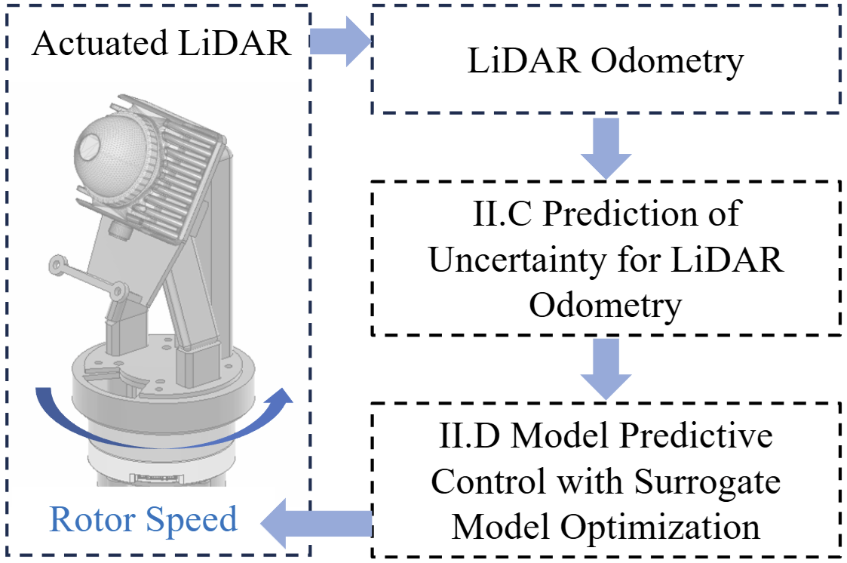
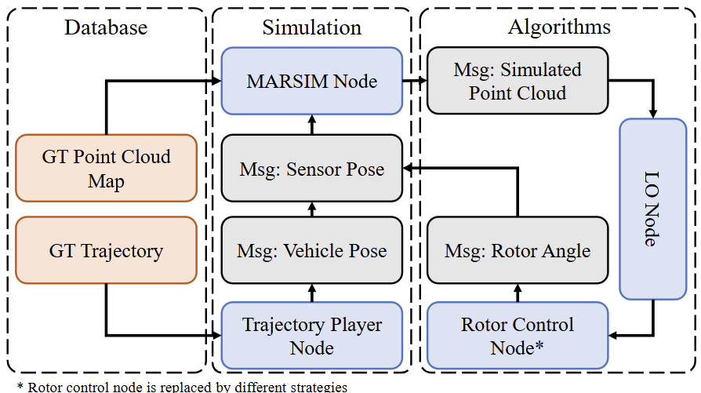
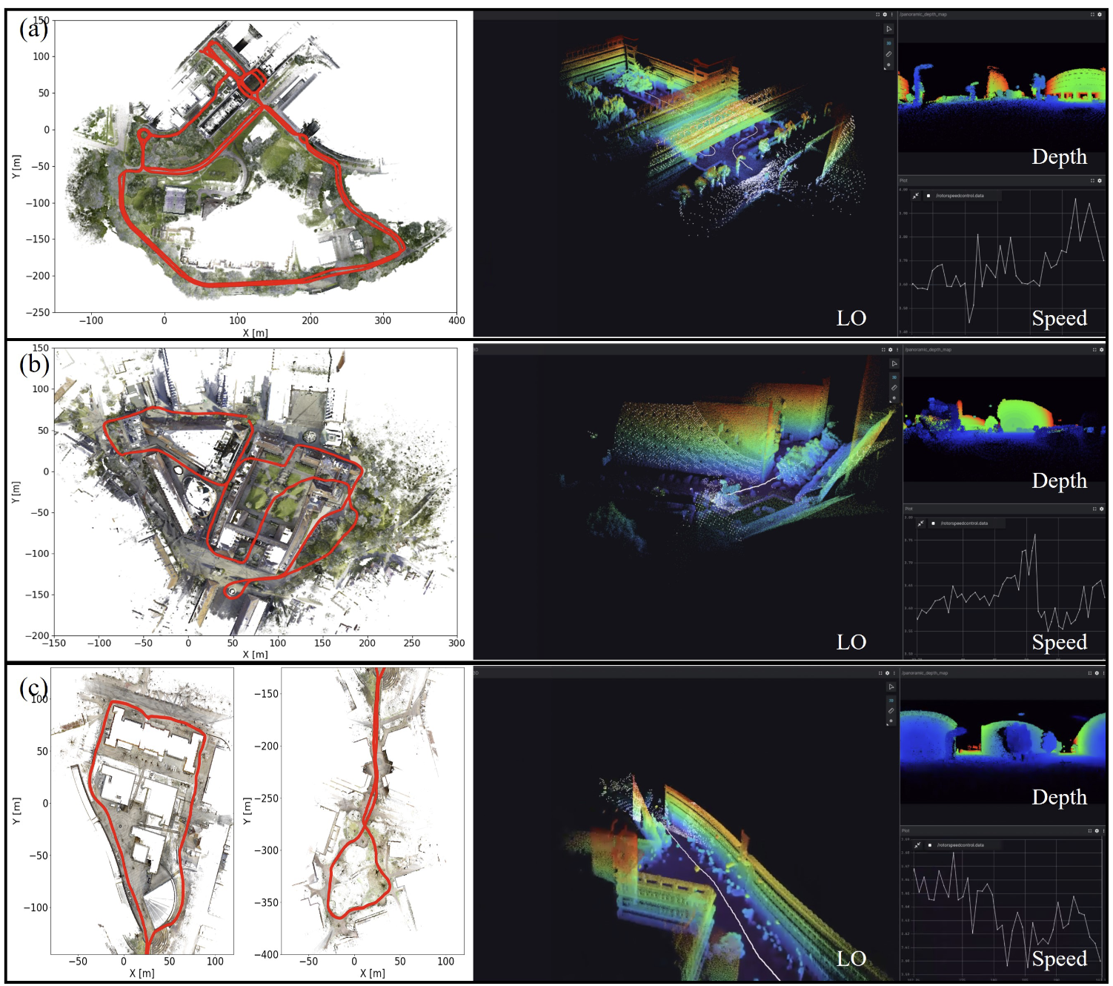
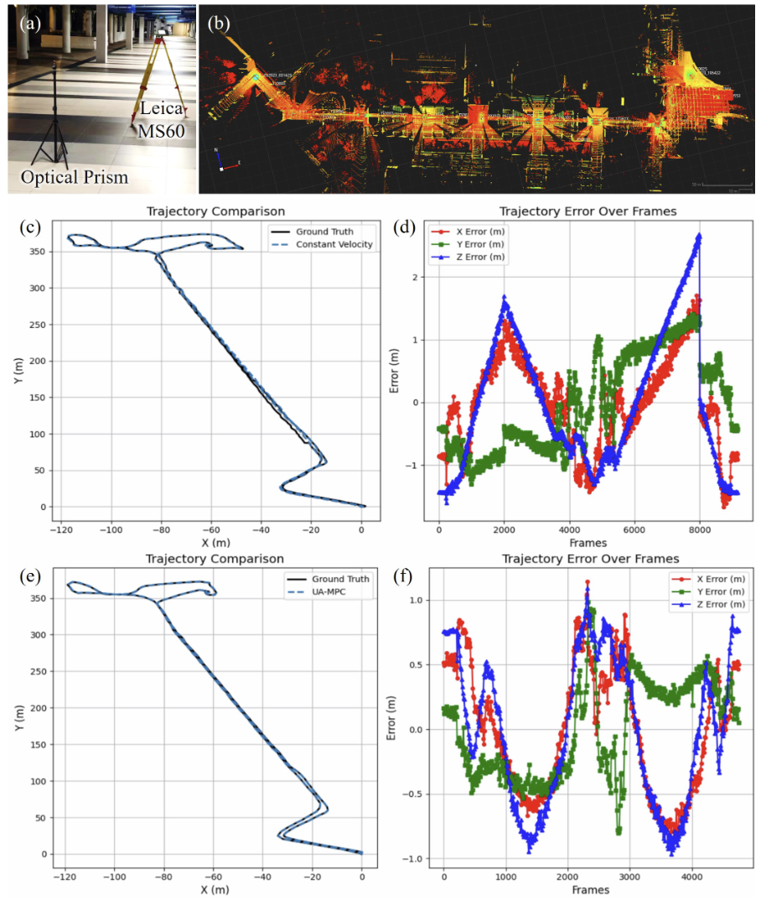
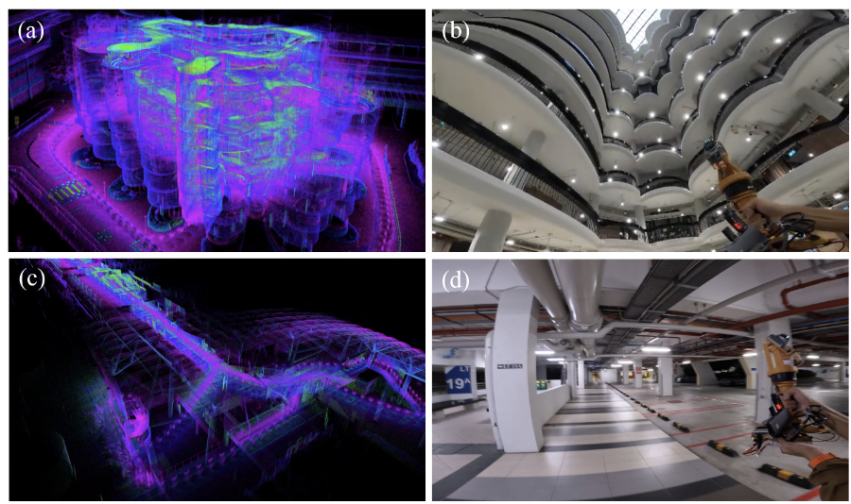





UA-MPC: Uncertainty-Aware Model Predictive Control for Motorized LiDAR Odometry
Jianping Li, Xinhang Xu, Jinxin Liu, Kun Cao, Shenghai Yuan, Lihua Xie
Nanyang Technological University, Singapore
TongJi University, China
Made by Dr. Yuan Shenghai
Motivations
Motorized LiDAR systems can expand the Field of View (FoV) without adding multiple scanners, but existing motorized LiDAR systems often rely on constant-speed motor control, leading to suboptimal performance in complex environments.
To solve the optimaTo improve the scanning accuracies while maintaining the scanning efficiency, UA-MPC, an uncertainty-aware motor control strategy, considering the odometry accuracies and scanning efficiency.
l motor control problem efficiently,discrete observabilities of the LiDAR odometry arefirst predicted using ray tracing.
We developed the first motorized LiDAR simulation environment under ROS with the adaptation to the existing SLAM dataset.
Methodology
UA-MPC
Simulation Framework
Experiment Result
Real Demonstration
Interested?
Scan the QR code, watch the video, and learn more.
Simulation Results
Accuracy Comparison

Slide 2
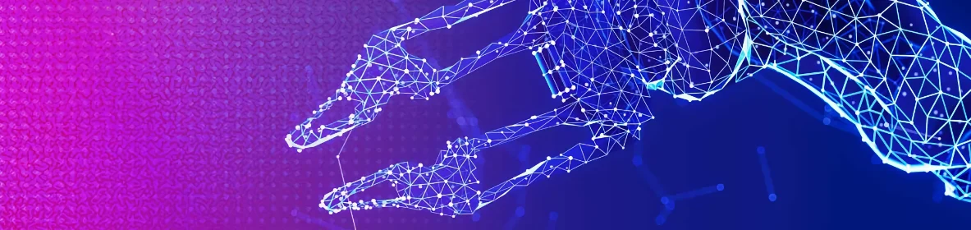
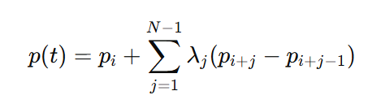
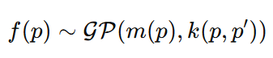
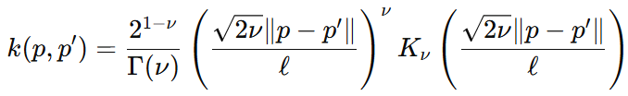
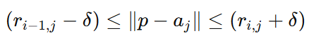
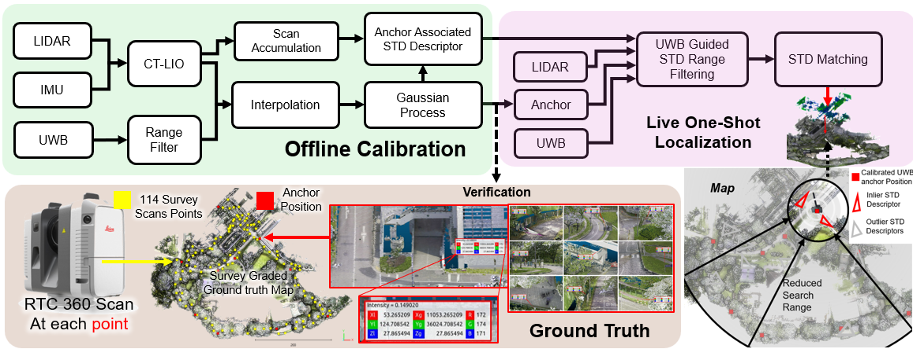
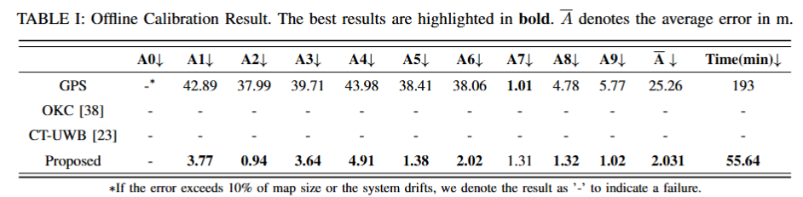
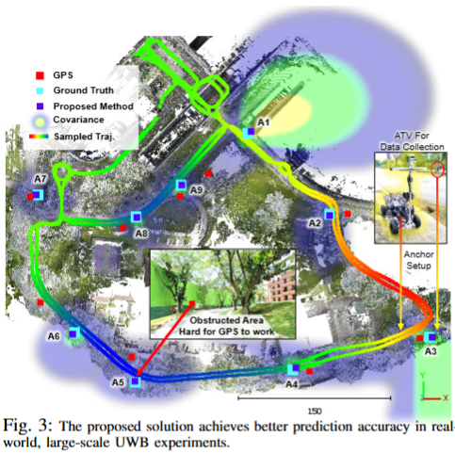
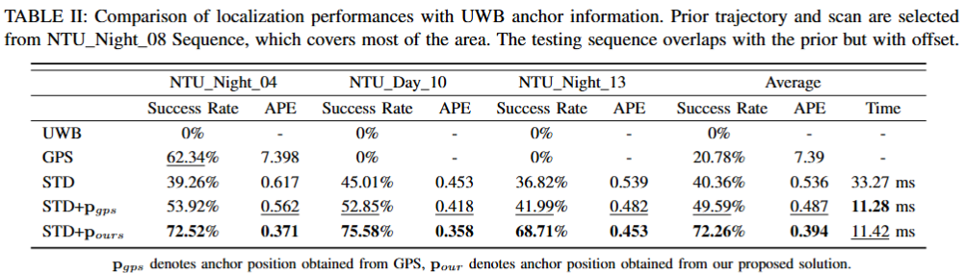


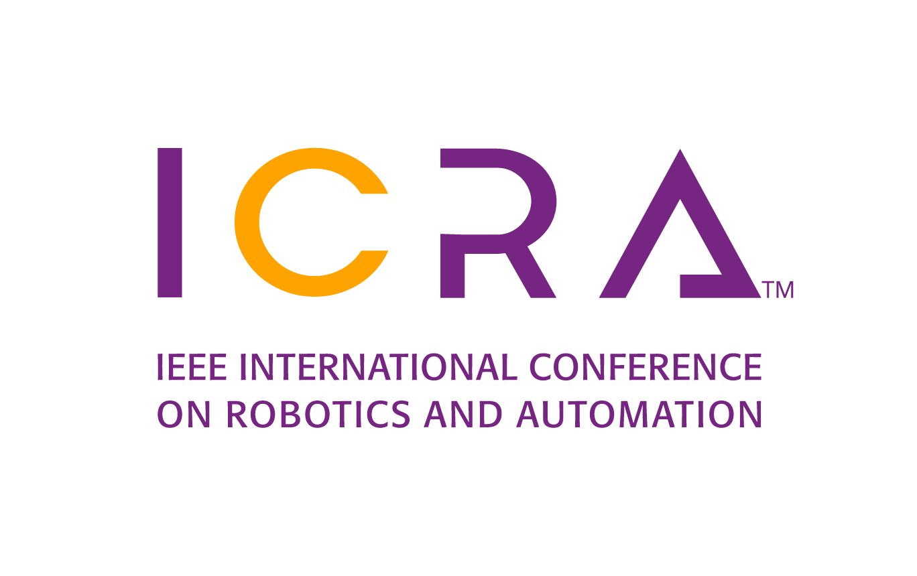
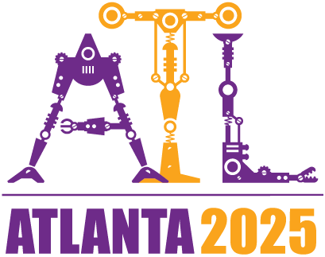
Large-Scale UWB Anchor Calibration and One-Shot Localization Using Gaussian Process
Shenghai Yuan, Boyang Lou , Thien-Minh Nguyen , Pengyu Yin , Jianping Li , Xinhang Xu , Muqing Cao , Jie Xu , Siyu Chen , Lihua Xie
Nanyang Technological University, Singapore
Made by Dr. Yuan Shenghai
Motivations
Proposed Solution
UWB for Precise Localization:
Effective for small indoor environments but unreliable in large, obstructed areas like seaports and warehouses.
Challenges: Non-Line-of-Sight (NLoS) conditions, signal loss, and high calibration cost.
Limitations of Existing Methods:
Most approaches rely on Line-of-Sight (LoS) and are confined to small areas.
GPS-based methods fail in obstructed environments.
Multi-robot and networked calibration are complex and hardware-dependent.
Existing UWB-IMU fusion methods suffer from drift and noise in large-scale settings.
UWB-LiDAR Fusion with Gaussian Process (GP): Generate continuous trajectory using Continuous-Time LiDAR-Inertial Odometry (CT-LIO).
Align UWB and LiDAR poses via B-spline interpolation:
Gaussian Process Regression: Estimate anchor positions with GP:
One-Shot Localization: Filter UWB-based search space to improve descriptor matching:
Frameworks
Experiment Result
Calibrations
Localizations

Slide 3

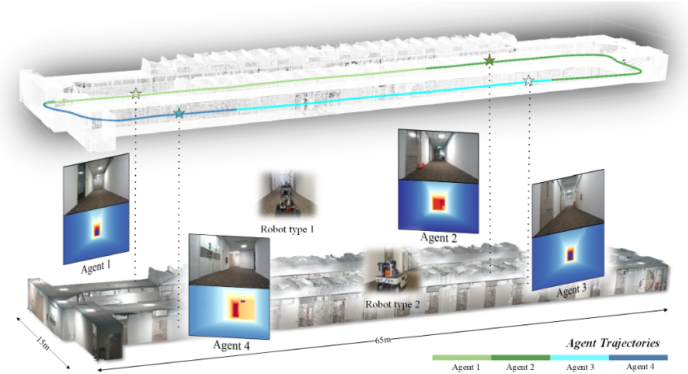
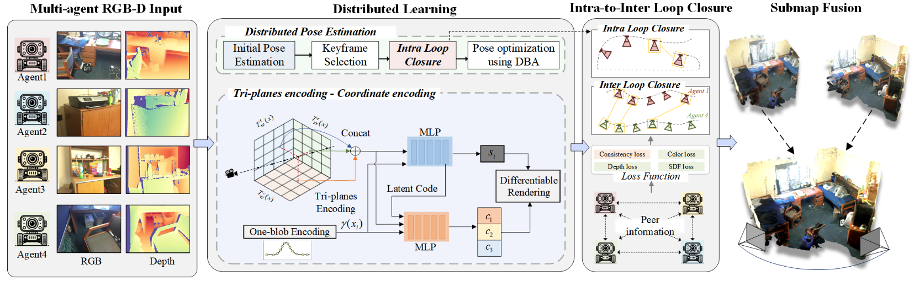
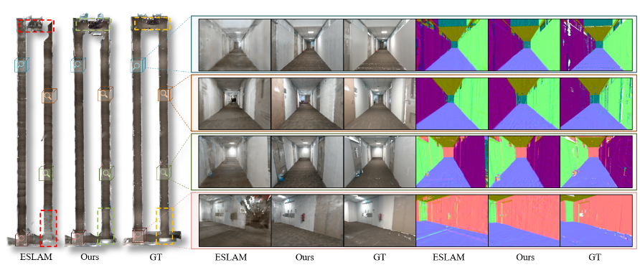


MNE-SLAM: Multi-Agent Neural SLAM for Mobile Robots
Tianchen Deng¹, Guole Shen¹, Chen Xun², Shenghai Yuan², Tongxin Jin², Hongming Shen²,Yanbo Wang¹, Jingchuan Wang¹, Hesheng Wang¹, Danwei Wang², Weidong Chen¹
Shanghai Jiao Tong University, China
Nanyang Technological University, Singapore
Made by Dr. Yuan Shenghai
Motivations
Existing neural SLAM methods are limited to single-agent settings.
Multi-agent SLAM suffers from high bandwidth and poor scalability.
No prior fully distributed neural SLAM exists for real-world deployment.
This work proposes a peer-to-peer multi-agent SLAM with efficient communication.
Enables joint mapping, tracking, and global consistency across agents.
Methodology
Experiment Result

Slide 4
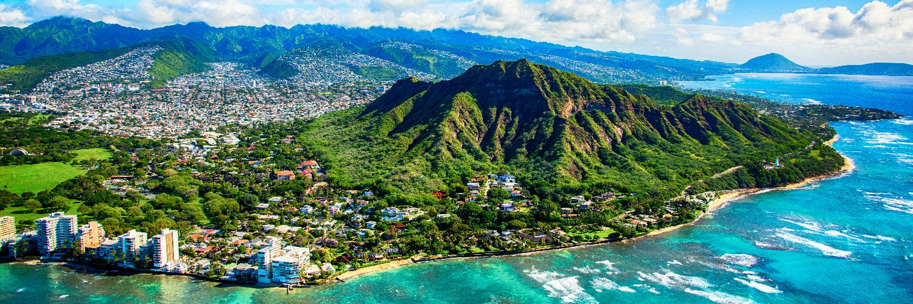
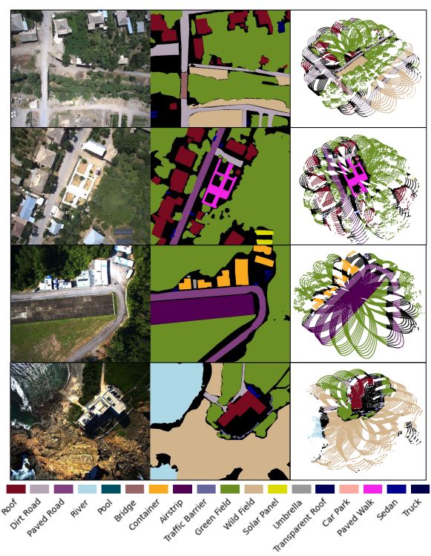
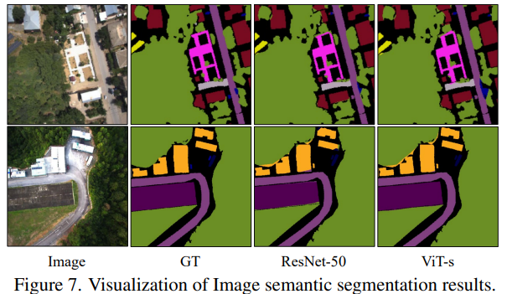
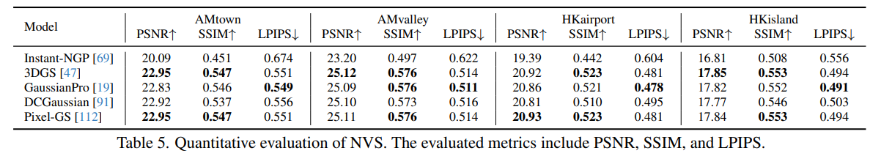
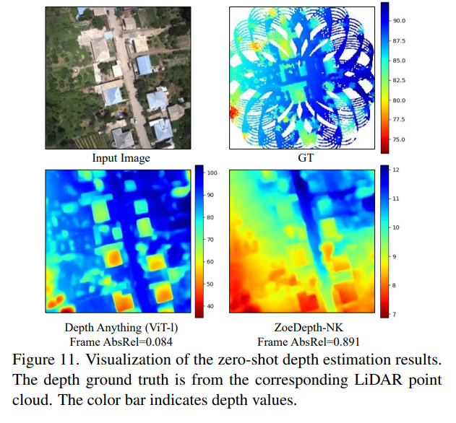
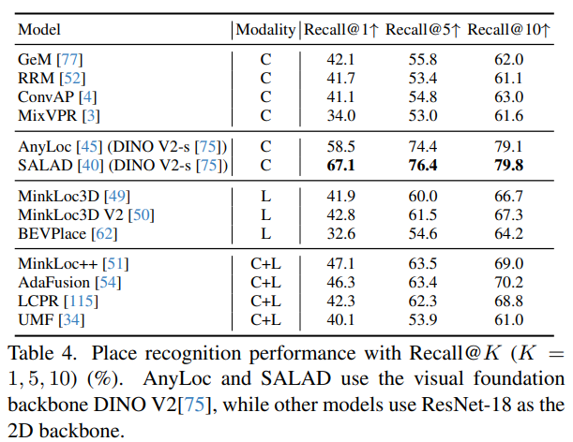
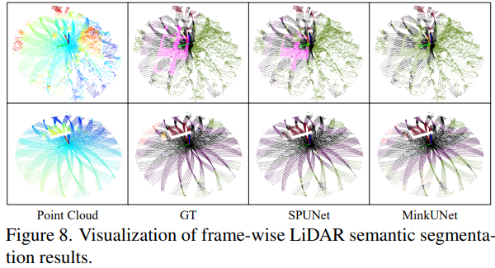

UAVScenes: A Multi-Modal Dataset for UAVs
Sijie Wang, Siqi Li, Yawei Zhang, Shangshu Yu, Shenghai Yuan, Member, IEEE
Rui She, Quanjiang Guo, JinXuan Zheng, Ong Kang Howe, Leonrich Chandra, Shrivarshann Srijeyan, Aditya Sivadas, Toshan Aggarwal, Heyuan Liu, Hongming Zhang, Chujie Chen, Junyu Jiang,
Lihua Xie, Fellow, IEEE , Wee Peng Tay
Nanyang Technological University, Singapore
Made by Dr. Yuan Shenghai
Motivations
UAVs are increasingly applied in aerial taxis, logistics, agriculture, inspection, and emergency response.
Existing UAV datasets lack frame-wise multi-modal annotations (image + LiDAR), hindering higher-level perception tasks.
UAVScenes fills this gap by enabling semantic segmentation, depth estimation, localization, place recognition, and novel view synthesis.
Dataset Overview
Built on MARS-LVIG with added semantic masks, instance-level annotations, and 6-DoF camera poses.
120k+ image-LiDAR frames with aligned annotations across 19 classes (16 static + 2 dynamic + background).
Captures towns, valleys, islands, and airports with multiple traversals.
Annotation Pipeline
SfM + DJI Terra used to reconstruct 6-DoF poses.
Semantic masks rendered from 3D maps; dynamic objects manually labeled (280k+ instances).
LiDAR annotations projected from images and manually verified.
Benchmark Tasks & Experiments

Slide 5
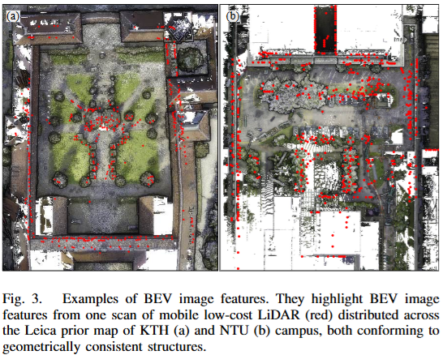
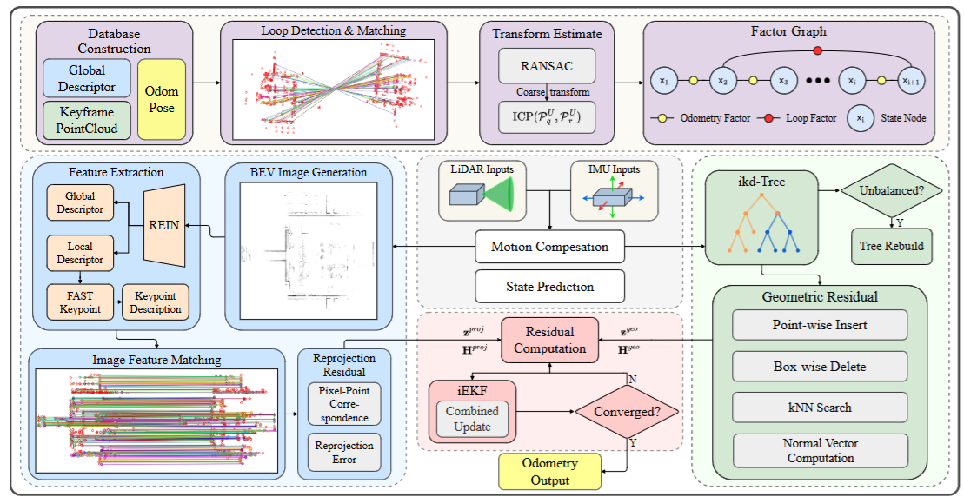
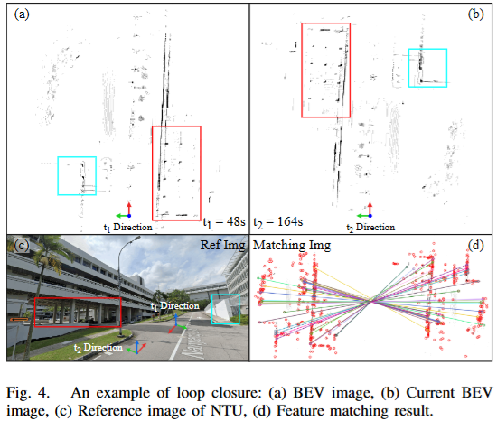
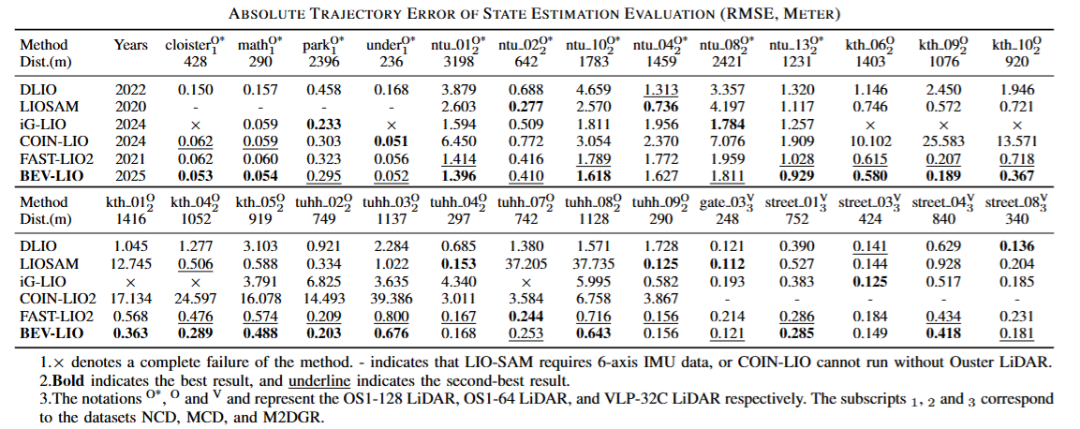






BEV-LIO(LC): BEV Image Assisted LiDAR-Inertial Odometry with Loop Closure
Haoxin Cai, Shenghai Yuan, Xinyi Li, Junfeng Guo, and Jianqi Liu
Guangdong University of Technology, China
Nanyang Technological University, Singapore
Made by Dr. Yuan Shenghai
Motivations
LiDAR-based SLAM struggles with sparse, irregular point clouds and loop closure.
BEV (Bird’s Eye View) image representations provide robust, scale-consistent 2D structure for LiDAR data.
This work bridges BEV feature-based perception with real-time LiDAR-Inertial Odometry and loop closure.
Key Contributions
🧠 Tightly-Coupled iEKF with BEV Reprojection Error: Combines geometric and BEV-based reprojection residuals via analytic Jacobians.
🔁 Robust Loop Closure: Uses global BEV descriptors and KD-tree for fast candidate retrieval, RANSAC + ICP refinement, and factor graph integration.
🧪 Superior Performance: Outperforms state-of-the-art LIO and LC methods across 3 public datasets.
Methodology
Experimental Results
Paper URL
Code Release

Slide 6
BEV-LIO(LC): BEV Image Assisted LiDAR-Inertial Odometry with Loop Closure
Haoxin Cai, Shenghai Yuan, Xinyi Li, Junfeng Guo, and Jianqi Liu
Guangdong University of Technology, China
Nanyang Technological University, Singapore
Motivations
LiDAR-based SLAM struggles with sparse, irregular point clouds and loop closure.
BEV (Bird’s Eye View) image representations provide robust, scale-consistent 2D structure for LiDAR data.
This work bridges BEV feature-based perception with real-time LiDAR-Inertial Odometry and loop closure.
Key Contributions
🧠 Tightly-Coupled iEKF with BEV Reprojection Error: Combines geometric and BEV-based reprojection residuals via analytic Jacobians.
🔁 Robust Loop Closure: Uses global BEV descriptors and KD-tree for fast candidate retrieval, RANSAC + ICP refinement, and factor graph integration.
🧪 Superior Performance: Outperforms state-of-the-art LIO and LC methods across 3 public datasets.
Methodology
Experimental Results
Paper URL
Code Release
Made by Dr. Yuan Shenghai

